Slide 1

Train Arrival Estimation
Presented By:
Sheil Pathare
Ashish Mandal
Asif Ikbal Hussain

Slide 2
Problem Statement
Why is this problem Important?
Trains often result in delays. This model will help in suggesting an accurate arrival and departure time using past data of the same train at different stations and predict accurate timings to check for delays

Slide 3
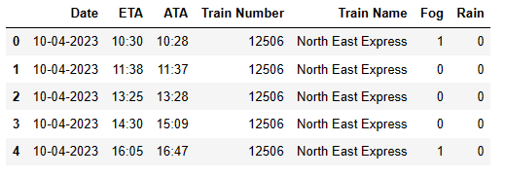
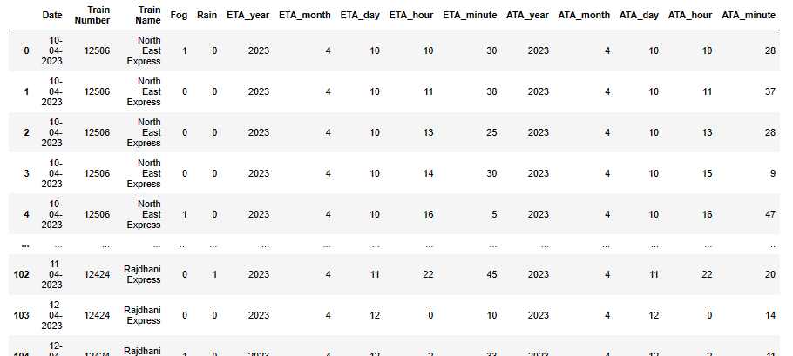
Progress
Collection of Datasets
Multilinear Regression
Calculating accurate arrival time and departure

Slide 4
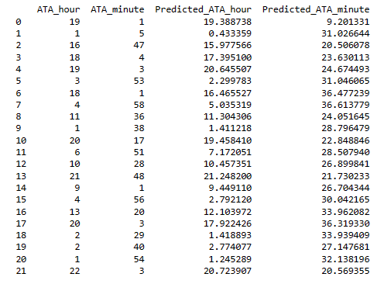
Result

Slide 5
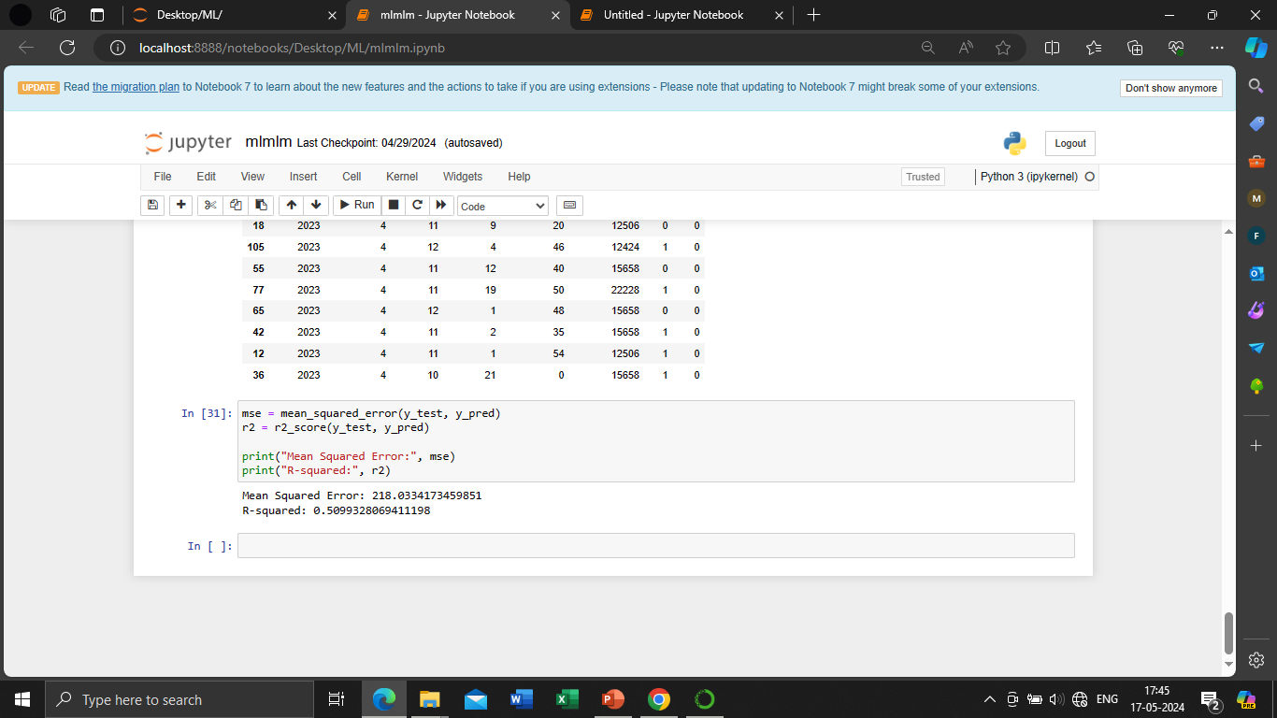
Accuracy

Slide 6
Thank you

